Slide 1
America at the turn of the Century

Slide 2
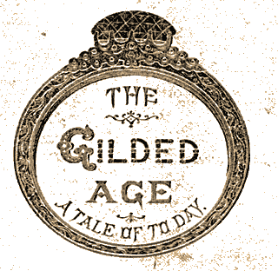
Gilding is the process of covering something in a thin layer of Gold, making it seem more valuable than it is.
This time period was one of rapid Industrialization and Growth of the American Economy
However, it also caused rampant poverty, overcrowding, and corruption within the country

Slide 3
Industrialization
The movement away from an agricultural economy towards an economy based on the manufacturing of goods and services.
Allows for the Mass Production of goods which used to be made individually by hand
Businesses grow rapidly as a result
Encouraged inventors to create new machines and methods of accomplishing tasks

Slide 4
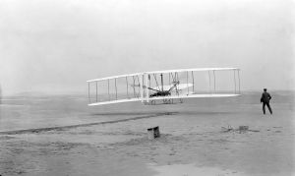
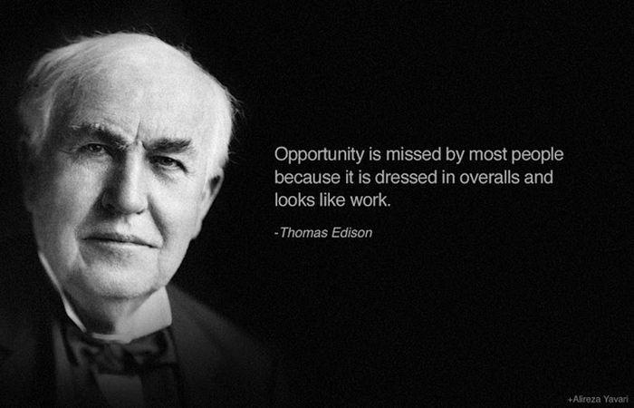
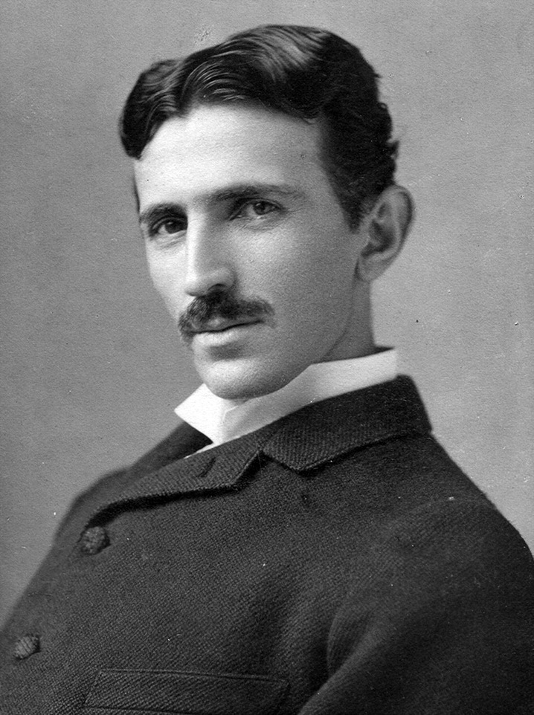
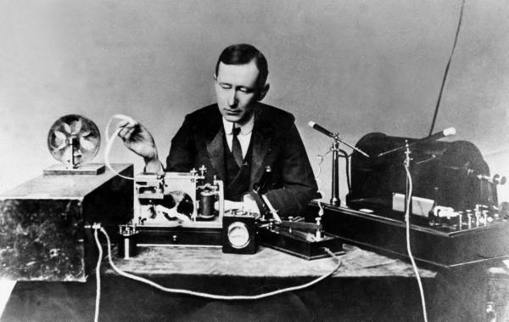
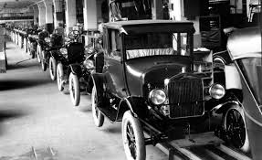
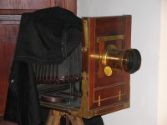
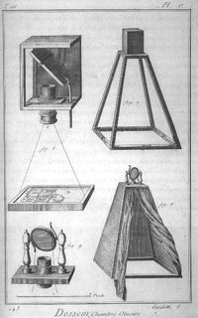
Inventors/Inventions The government issues Patents which protect inventors rights to their “Intellectual Property”
Eli Whitney
Cotton Gin(1793)
Interchangeable parts (1798)
Thomas Edison
Perfected the light bulb in 1880,
and motion pictures
Organized power plants
Established first research lab
Alexander Graham Bell
Telephone (1876)
Henry Ford
Assembly Line
George Eastman
Camera (1885)
Samuel Morse
Telegraph (1837)
Wright Brothers
Airplane (1903)
Marconi and Tesla
Radio
Henry Bessemer
Bessemer Steel Process
Inexpensive, high quality steel
Wright Brothers on 1903 Flight
Tesla
Marconi
19th Century Camera
Alexander Graham Bell

Slide 5
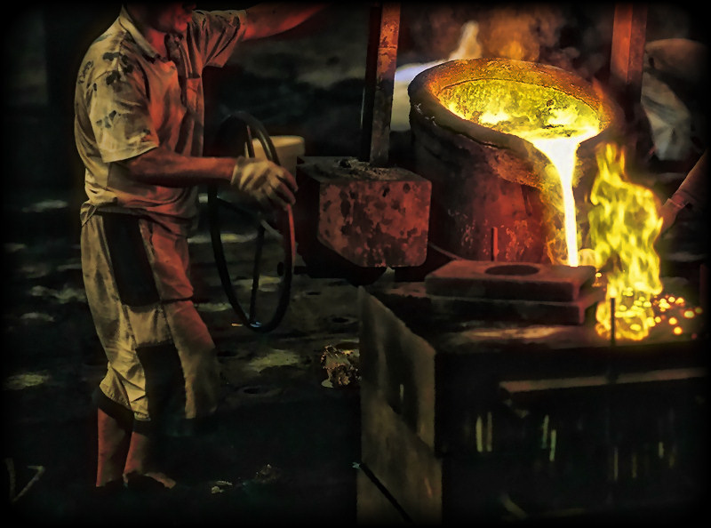
Importance of Steel
Stronger than most other metals of the period
Pliable, meaning it could bend without breaking
Lighter than iron
Resists rust and corrosion
Lower production cost after the advent of the Bessemer process
Engineers use steel to create skyscrapers and long bridges (Brooklyn Bridge)
Steel is used in farm equip., canned goods, and railroads

Slide 6
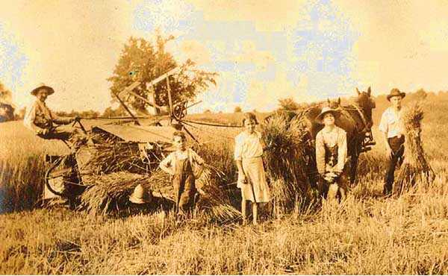
Agricultural Advances
New inventions during the Industrial Age increased the speed and effectiveness of American Farms

Slide 7
John Deere and the plow
In 1836, John Deere invented a lightweight plow with a steel cutting edge.
Deere’s plow made preparing the ground for planting much less work.

Slide 8
Cyrus McCormick and the reaper
Cyrus McCormick invented a mechanical reaper, to cut grain from the fields.
This allowed farmers to plant much more seed because they could harvest it easier.

Slide 9
The Threshing Machine
The threshing machine separated the kernels of wheat from the husks, which was a far faster way of getting wheat than threshing by hand.
Like the reaper, the threshing machine increased the amount of wheat an individual farmer could grow.

Slide 10
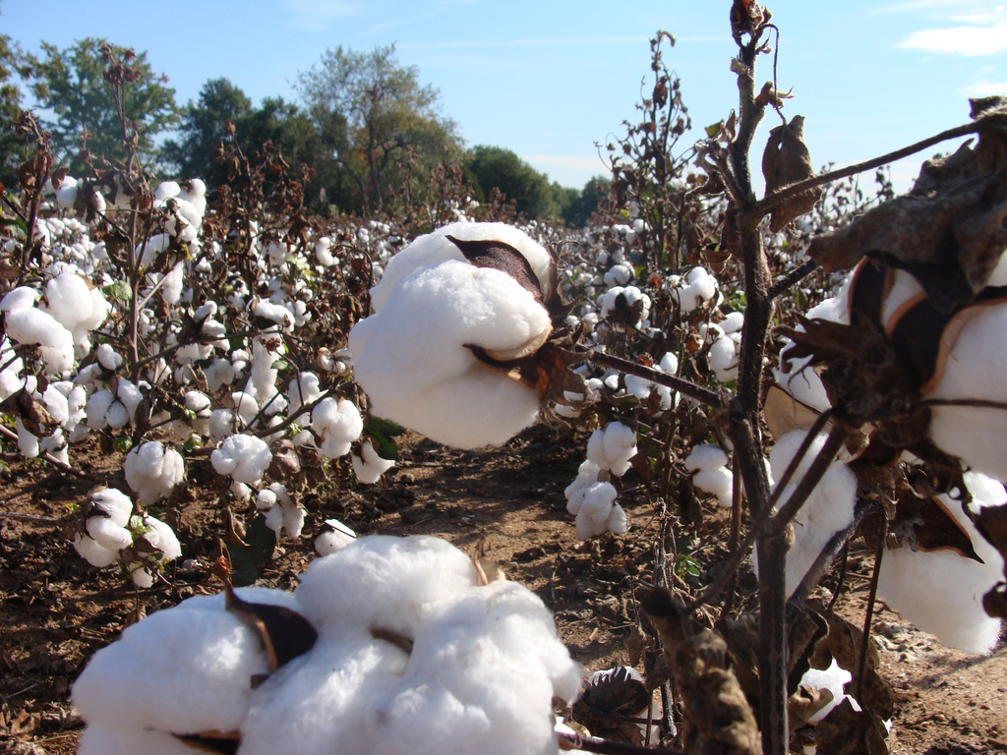
The cotton gin
Eli Whitney also invented the cotton gin.
The gin took the seeds out of the cotton, which was much faster than doing it by hand.
The cotton gin also greatly expanded the need for slaves, and was one factor which led to the outbreak of the Civil War

Slide 11
Significance
New technologies provided the country with the means to flourish and grow
Better farming tech. = more food
More Food = more people, and fewer people having to farm leaving them able to innovate and manufacture goods
More people available for manufacturing and innovation = increased industrialization

Slide 12
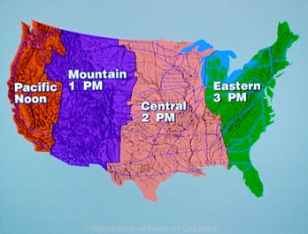
Impact of Railroads on America during the Gilded Age
Benefits
Stimulated growth of other industries (steel, iron, coal, lumber, livestock)
Lead to the growth of cities
Helped increase westward expansion of America
Standard time zones were created to get everyone on correct time
It connected country in a way it had never been before
Corruption
Charged much higher rates to small western farmers
Gave discounts to large Agri-business
Bribed members of Congress and received massive land grants

Slide 13
Railroad Legislation
Interstate Commerce Act of 1887
Set Government oversight of the railroad industry to prevent unfair shipping prices
Led to more financial problems (some railroads were forced out of business, which led to the Panic of 1893)
This allowed the larger companies to start buying up the railways, which paved the way for Big Businesses

Slide 14
Rise of Big Business
Running smaller companies out of business and/or purchasing the competition became the norm
This consolidation of influence in the nations industries into the hands of a few wealthy business owners led to the rise of “Big Business”
Big Business used many strategies to try and gain a larger “Market Share” or control of industries

Slide 15
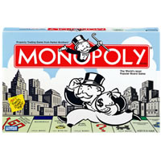
Horizontal Consolidation
Is the idea that one company assumes control of all the competing companies, creating a Monopoly.
Monopoly- When one company or supplier controls all or most of a certain industry or commodity.

Slide 16
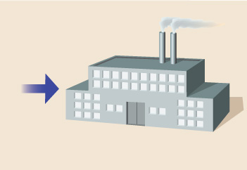
Horizontal Consolidation
purchased
by
Rockefellar
Independent Oil refineries
Standard Oil Company

Slide 17
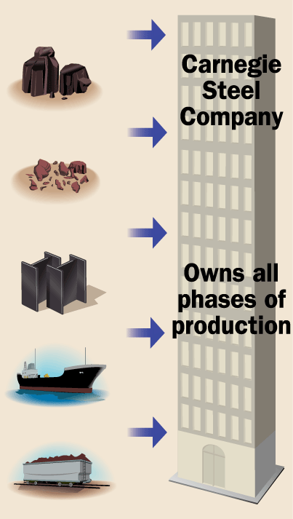
Vertical Integration
Coal fields
purchased by Carnegie
The idea of controlling every aspect of producing, selling and shipping a product
This can also result in a monopoly, commonly referred to as a Vertical Monopoly.
Iron ore deposits
purchased by Carnegie
Steel mills
purchased by Carnegie
Ships
purchased by Carnegie
Railroads
purchased by Carnegie

Slide 18
Vertical and Horizontal Integration

Slide 19
Robber Barons or Captains of Industry?
Are these big business men good guys or bad guys?

Slide 20
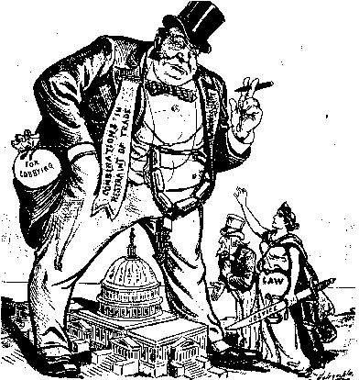
Robber Barons or Captains of Industry?
Robber Barons
Drove out competing businesses with mean, though not yet illegal, practices.
Business leaders who treated workers poorly or with little consideration
Bribed political officials to get what they wanted

Slide 21
Robber Barons or Captains of Industry?
Captains of Industry
Business leaders who served the nation in a positive way, Usually through philanthropy
Philanthropy is the act of doing something for the good of others such as:
Creating jobs
Building up the nation’s wealth, and power
Financing parks, schools, hospitals, libraries, etc……
Donating to, or organizing, Charity Organizations

Slide 22
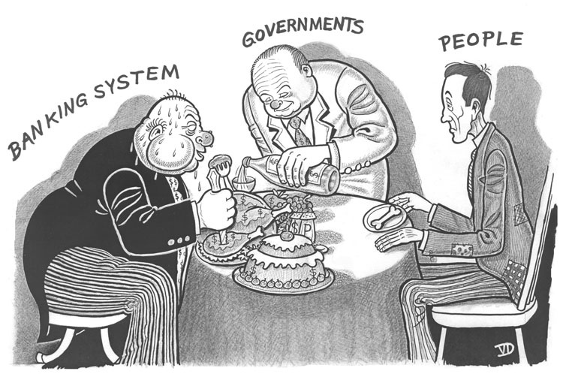
Political Corruption
Many politicians in the country at this time turned a blind eye to the problems of corruption and unfair business practices
This style of government which leaves business to do as it will is called Laissez Faire government.
Laissez Faire is a French term which means leave it alone

Slide 23
Abuses of Big Business
Big Businesses would do anything to make more money
Employees were generally paid very little for long hours of work (usually 12 hours a day 6 days a week)
Working conditions were poor and often dangerous. IE. Sweatshops
Women, Children, and Immigrants were utilized by the thousands as cheap labor
Many people lived in Company Towns where they paid most of their wage back to the company in exchange for rent and the things they need to survive

Slide 24
Issues of the Gilded Age
New Immigration
Hundreds of thousands of new immigrants came to America to make a living in the newly expanding Industrial Economy
Most of these “New Immigrants” came from areas in Southern and Eastern Europe
Most were poor with little or no way of supporting themselves in America
They were also more likely to settle in the cities near factory jobs than were the “Old” immigrants who mainly moved west and farmed.

Slide 25
Issues of the Gilded Age
New Immigration
Another group that was immigrating to the U.S. in large numbers at this time was the Chinese
Nativists- or people who thought immigration was ruining the country were unhappy with the Chinese, Jews, and Catholics moving into the country
This led to legislation limiting who could enter the country
The Chinese Exclusion Act outlawed Chinese laborers from immigrating to the country in 1882.

Slide 26
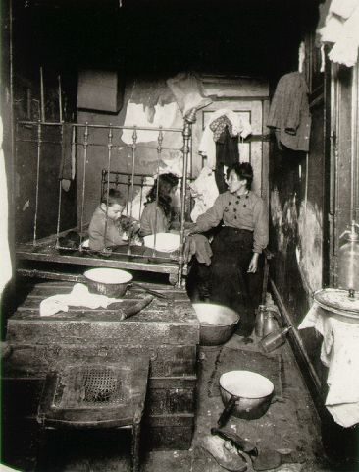
Issues of the Gilded Age
New Immigration
The movement of people towards cities is called Urbanization
U.S. industrial cities became massively over crowded during the Gilded age
Immigrants rented Tenements which are apartments that are very small and/or run down

Slide 27
The wealthy used Social Darwinism to explain the plight of the new immigrants and other poor working class people
Social Darwinism
The rich are rich because they are superior, the poor because they are inferior. “Success of the fittest”
Used to justify racial, ethnic, and now socio-economic inequality in America

Slide 28
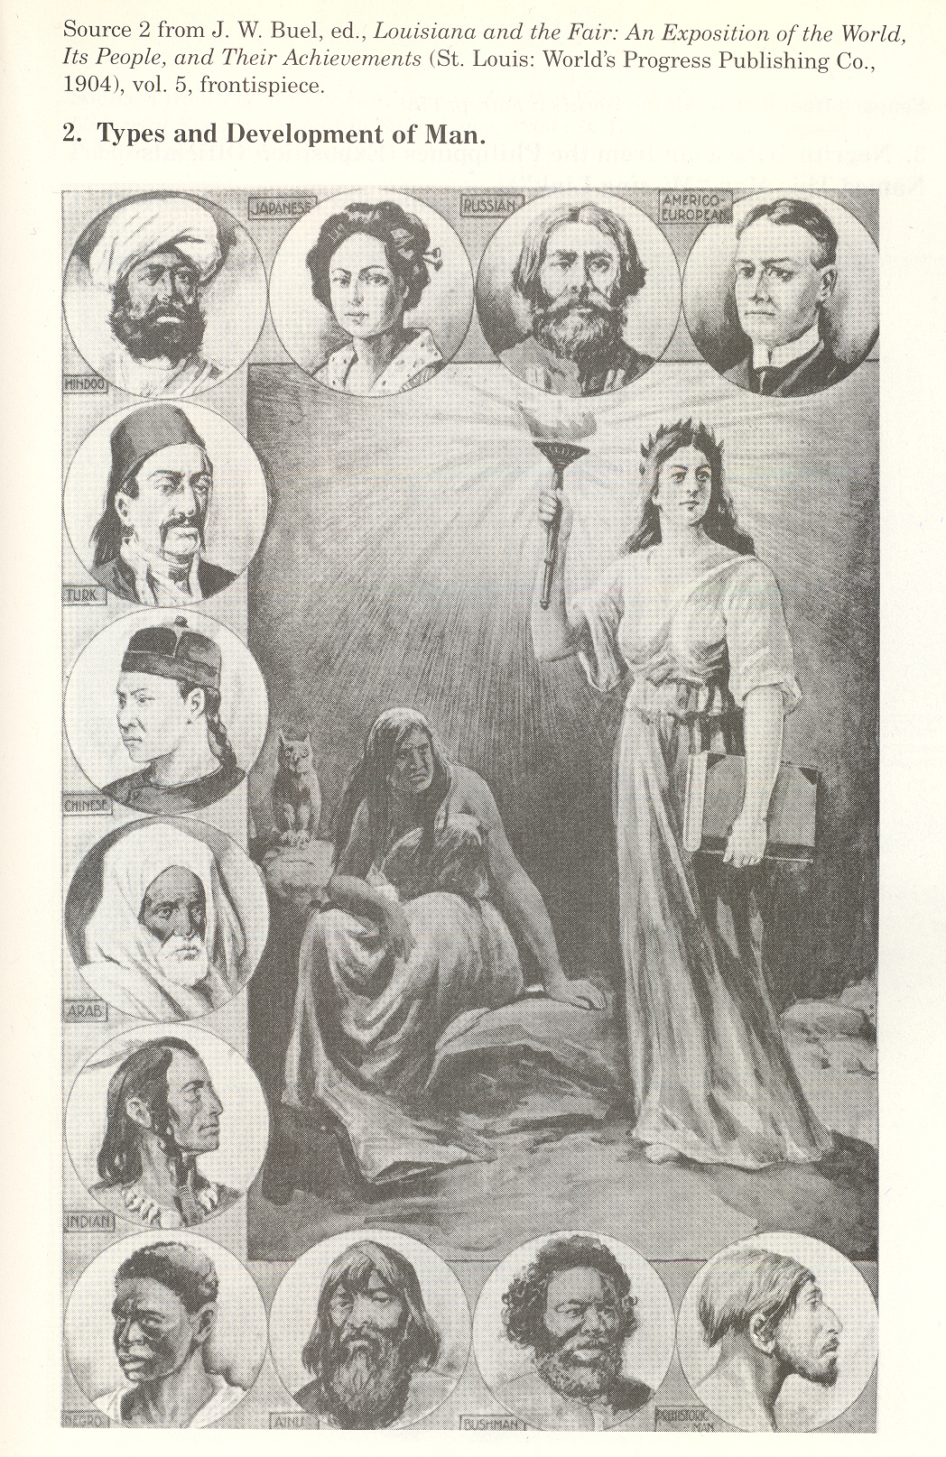
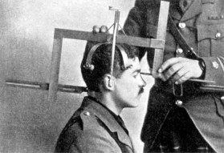
Social Darwinism as Science

Slide 29
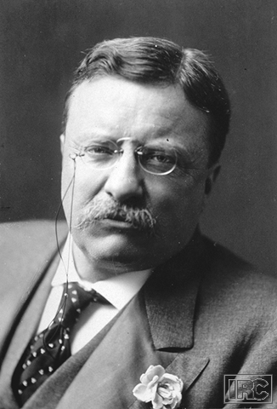
Progressive Reform
Progressives were reformers who attempted to solve problems caused by industry, growth of cities and laissez faire Government.

Slide 30
MUCKRAKERS
journalists and photographers who exposed the abuses of wealth and power.
They felt it was their job to write and expose corruption in industry, cities, and government.
These Progressives exposed corruption but offered no solutions.

Slide 31
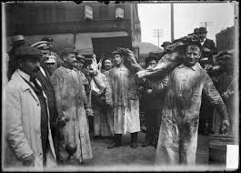
Muckrakers
Upton Sinclair- Exposed the filthy business practices in America Slaughter Houses in his book the Jungle

Slide 32
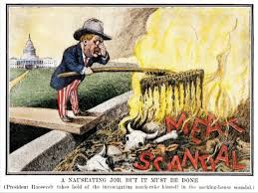
Progressive Reform
Theodore Roosevelt read the Jungle which encouraged him to champion progressive change
This led to the creation of the Pure Food and Drug Act and the Meat Inspection Act

Slide 33
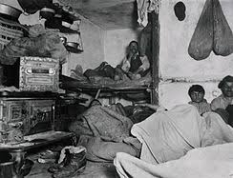
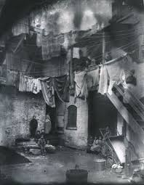
Muckrakers
Jacob Riis- Showed the horrible living conditions of immigrants in NY Slums in a photo journal entitled How the Other Half Lives

Slide 34
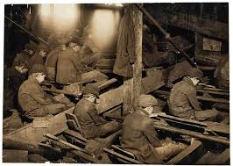
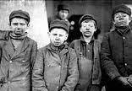
Muckrakers
John Spargo- Chronicled the poor working conditions and abuses of Child Laborers in his book The Bitter Cry of Children

Slide 35
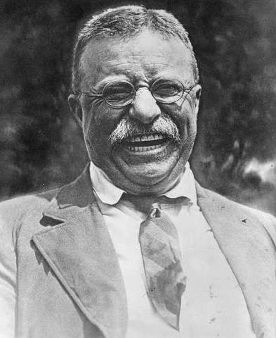
Theodore “Teddy” Roosevelt
Republican Vice President to the William McKinley
Became President after the assassination of McKinley in 1901
Championed progressive reform and expanded government regulation of the economy
Roosevelt’s progressive policies became known as the “Square Deal” which focused on 3 basic ideas: Protection of Consumers, Control of big business, Conservation of natural resources.

Slide 36
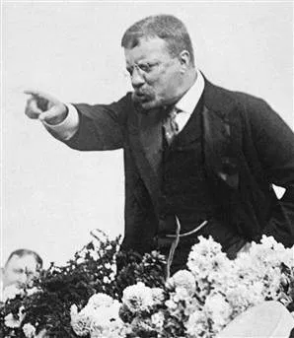
The Bully Pulpit
As a Progressive President he used
his influence to:
Expanded the powers of the ICC (Interstate Commerce Commission)to control Railroad rates
Enforced the Sherman Anti-Trust Act (1890)
Trust Buster: he broke up many Monopolies
Greatly increased the National Parks System to enforce the conservation of natural resources
Helped pass legislation leading to the creation of the FDA (Food and Drug Administration)

Slide 37
Organized Labor
All of the issues of Gilded Age eventually led to the rise in popular support for Unions
Unions are worker organizations whose purpose is to protect the rights and interests of it’s members
In order to do this with limited influence, Union’s employed many different tactics

Slide 38
Management vs. Labor
“Tools” of Management
“Tools” of Labor
“scabs”
P. R. campaign
Pinkertons
lockout
blacklisting
court injunctions
open shops
boycotts
support rallies
picketing
closed shops
organized strikes
“wildcat” strikes

Slide 39
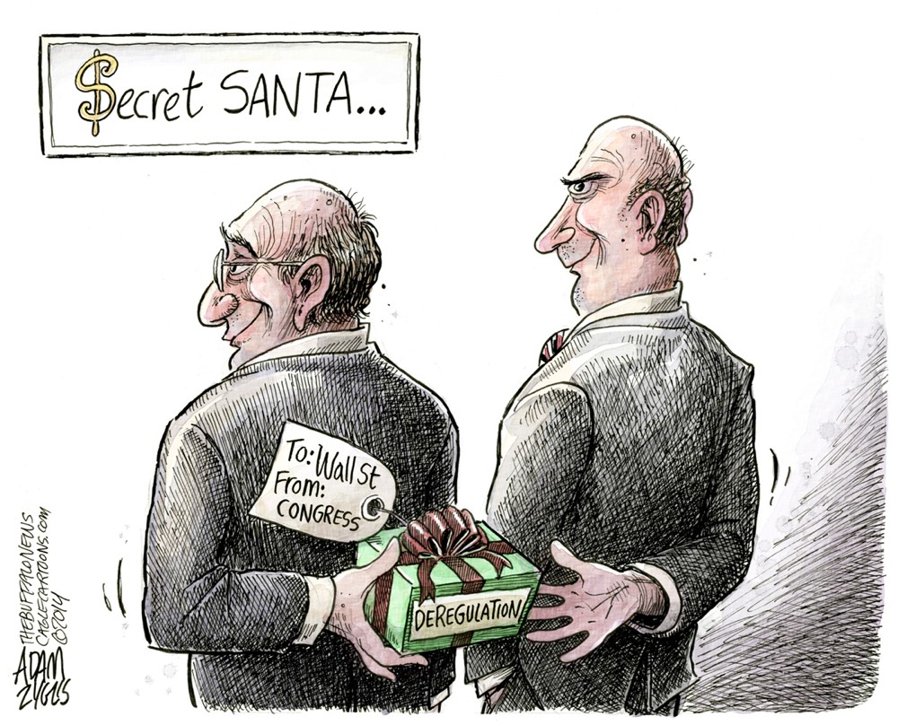
Which side did the Government take in labor disputes?
In general the government sided with management against the labor unions
Why do you think that was the case?

Slide 40
Progressive Era Reforms
8 Hour Work Day and 5 day work weeks
Laws limiting Child Labor
Laws regulating working conditions
Pure Food and Drug Act- regulating the food industry
Anti-Trust Laws- Outlawing Monopolies. Government Officials who worked to accomplish this became known as trust-busters
Regulations on rental properties
Expansion of Unions – Worker benefits and Rights increased

